Slide 1



CARBON CAPTURE
WEEK 2
Different Types of Carbon Capture Technology and processes.

Slide 2


Let's spell it out!
TOPIC OUTLINE
Day1- Post Combustion Capture Technology of Carbon Capture
Day2- Oxy Fuel Combustion Capture System
Day3- Pre Combustion Capture System
Day4 -New Future Technologies

Slide 3

DAY - 1
POST COMBUSTION CAPTURE TECHNOLOGY OF CARBON CAPTURE

Slide 4
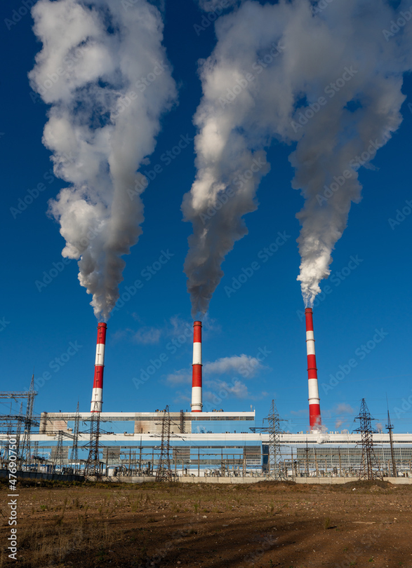

Current anthropogenic CO2 emissions from stationary sources come mostly from combustion systems such as power plants, cement kilns, furnaces in industries and iron and steel production plants . In these large-scale processes, the direct firing of fuel with air in a combustion chamber has been (for centuries, as it is today) the most economic technology to extract and use the energy contained in the fuel. Therefore, the strategic importance of post-combustion capture systems becomes evident when confronted with the reality of today’s sources of CO2 emissions.

Slide 5


When separating CO2 from the exhaust gases after combustion (post-combustion separation), a chemical is utilised to bind CO2 and separate it from the other flue gases. This is a technology that has been in use for decades. It is well developed commercially and suitable for both new projects and post-fitting onto existing point sources.
Post-combustion capture of CO2 in power plants is economically feasible under specific conditions. It is used to capture CO2 from part of the flue gases from a number of existing power plants. Separation of CO2 in the natural gas processing industry, which uses similar technology, operates in a mature market.

Slide 6
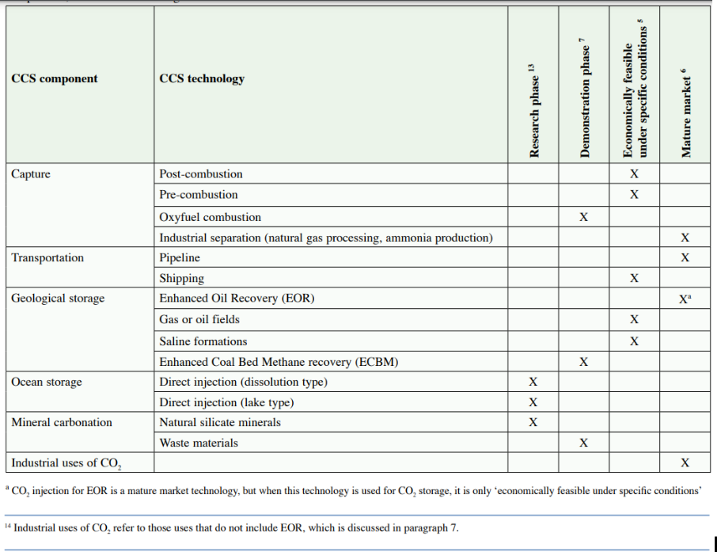

Slide 7
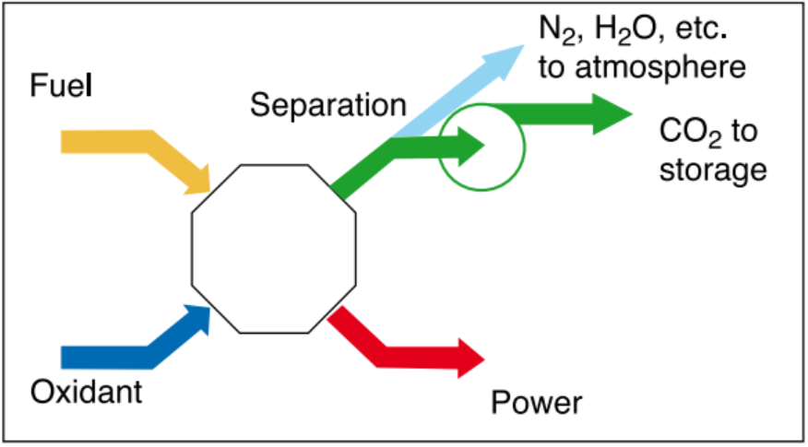

Post-combustion systems separate CO2 from the flue gases produced by the combustion of the primary fuel in air. These systems normally use a liquid solvent to capture the small fraction of CO2 (typically 3–15% by volume) present in a flue gas stream in which the main constituent is nitrogen (from air). For a modern pulverized coal (PC) power plant or a natural gas combined cycle (NGCC) power plant, current post-combustion capture systems would typically employ an organic solvent such as monoethanolamine (MEA).

Slide 8
CO2 contents of flue gases vary depending on the type of fuel used (between 3% for a natural gas combined cycle to less than 15% by volume for a coal-fired combustion plant). In principle post-combustion capture systems can be applied to flue gases produced from the combustion of any type of fuel. However, the impurities in the fuel are very important for the design and costing of the complete plant. Flue gases coming from coal combustion will contain not only CO2 , N2 , O2 and H2 O, but also air pollutants such as SOx , NOx , particulates, HCl, HF, mercury, other metals and other trace organic and inorganic contaminants. Today, capturing CO2 using amines is the most widespread method for post-combustion capture. Amine technology has already been used for decades to capture CO2 from both flue gas and natural gas. Several installations exist, of which several are operative.

Slide 9
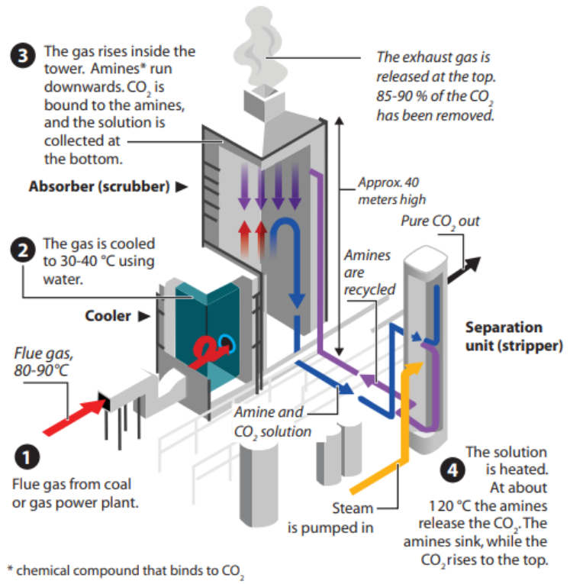
REMOVING CO2 USING AMINES
In this process the flue gas flows through a large tower called an absorber or scrubber. In this so-called absorption process, the gas comes into contact with the absorption fluid (amines mixed with water) fixing the CO2 in a relatively weak chemical bonding. The bound CO2 is transported to another tower, called a stripper, where the solvent is heated. This separates the CO2 from the amines in a process called regeneration.

Slide 10
The amines are then reused to absorb more CO2 . Flue gas from gas power plants has a temperature of about 80 – 100°C. The flue gas should usually be cooled to about 40°C before absorption. A 400MW gas power plant produces a flue gas stream of approximately 2.5 million Nm³/hour. To treat this amount of gas, an absorption tower with a diameter of 20-30metres and a height of 30-40 metres is required. This will be the largest single unit in the separation facility. The tower is filled with packing to provide the largest possible surface for contact between the upward-rising gas and downward-running amine solution. At the top, a washing tower removes any amine residue that has followed the flue gas stream before the CO2 -free flue gas is released into the atmosphere.

Slide 11



Efficiency ?
Plant efficiency is often termed as the percentage of fuel energy actually utilised in a given facility. In gas-fired plants the gas turbine converts almost 40 percent of the energy in the fuel to electricity. The hot exhaust gas is then used to produce steam which in turn drives a steam turbine converting another 20 percent of input fuel energy into electrical power. The added amount of electricity generated is called the electrical generation efficiency of the plant. The surplus energy now exists as heat, and when not used this is called waste heat.
The amount of energy utilised either as electrical power or heat compared to the energy input is called total plant efficiency.

Slide 12
Does Carbon Capture really decreases Efficiency ?
When CO2 from a power plant is captured, transported and stored it is generally said that efficiency decreases by some percentage points. This is not quite correct, as energy does not cease to exist. If capture equipment is integrated within the power plant, some of the heat that would otherwise have been wasted can be used in the capture process. The energy required for CCS in a power plant is mostly distributed as seven percentage points of electricity and 14 percentage points of heat. In conventional gas power plants 58 percent of the supplied fuel is converted into power, the rest wasted as heat unless used for district heating; In fact, the total energy utilisation for a plant with CCS would be 72 percent. If we acknowledge that CCS is at least as legitimate a use of power as any other use, a plant with integrated CCS is therefore more efficient than a conventional plant.

Slide 13
Current Status
Virtually all the energy we use today from carbon-containing fuels is obtained by directly burning fuels in air. This is despite many decades of exploring promising and more efficient alternative energy conversion cycles that rely on other fuel processing steps prior to fuel combustion or avoiding direct fuel combustion.
In particular, combustion-based systems are still the competitive choice for operators aiming at large-scale production of electricity and heat from fossil fuels, even under more demanding environmental regulations, because these processes are reliable and well proven in delivering electricity and heat at prices that often set a benchmark for these services.

